Slide 1
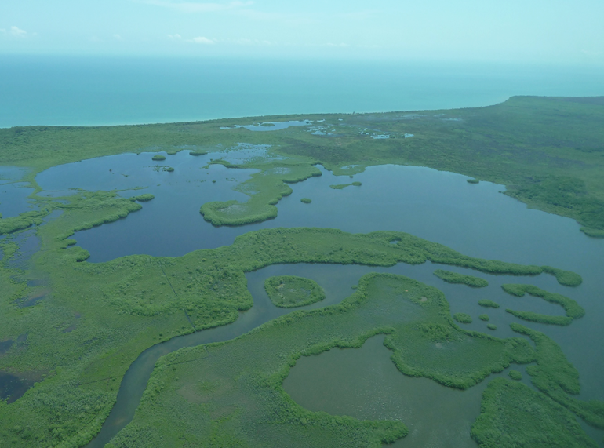
Drivers and Consequences of Mangrove Expansion into Temperate Salt Marsh
Ilka C. Feller, Richard Osman, John Parker, Wilfrid Rodriguez, Emily Dangremond, Susan Cook-Patton (Smithsonian Environmental Research Center)
Kyle Cavanaugh (UCLA) and Jim Kellner (Brown)
Daniel Gruner, Alex Forde, Cora Johnston, Mayda Nathan (University of Maryland College Park)

Slide 2
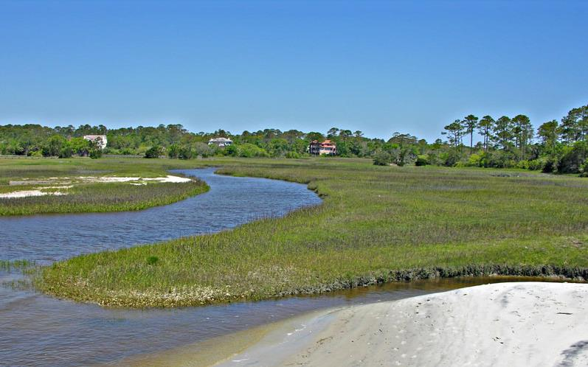
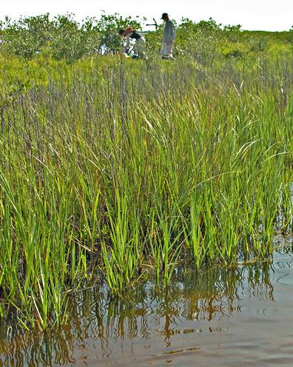
Temperate coastal wetlands = salt marshes
Smooth cordgrass (Spartina alterniflora)
Notes:
Mangroves and saltmarshes are coastal wetlands. Both occupy the intertidal zone in sheltered areas along estuaries, rivers, and coastlines.
Here is a temperate coastal wetland, vegetated primarily by salt-tolerant herbaceous species.
In fact, you will find similar salt marshes from Newfoundland to northern Florida.
But, there are other species… and species distribution within the saltmarsh differs from the low intertidal along the open water to high intertidal where the saltmarsh abut upland ecosystems.
Other saltmarsh grasses including Spartina patens, Distichlis spicata, Phragmites; also sedges, Scirpus olyneii, bullrushes where the salinity is a bit lower. There are even a few woody shrubs… Iva frutescens… saltbush; Baccharis halimifolia … groundsel tree; Myrica pensylvanica… bayberry

Slide 3
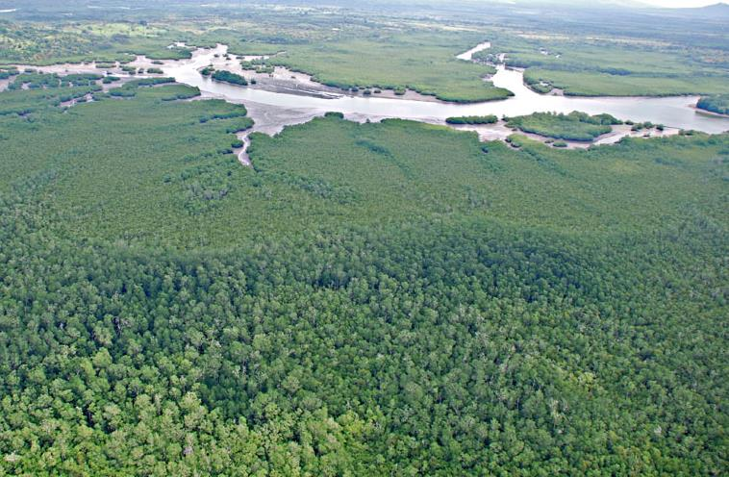
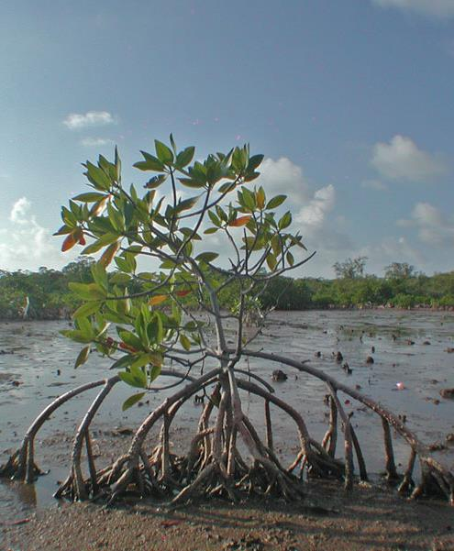
Tropical coastal wetlands = mangroves
Red mangrove (Rhizophora mangle)
Notes:
However, from Florida to southern Brazil, coastal wetlands along the Atlantic coast are dominated by mangroves.
Like salt marshes in the temperate zone, mangroves are composed of salt tolerant species growing in the intertidal in estuaries and alongside rivers and coasts.
However mangroves are trees… woody plants… which results in a dramatic departure in their structure and architecture from salt marshes.
In the temperate zone, 100% of the above ground biomass in herbaceous saltmarshes dies back.
Mangroves are all evergreen; only about 20% of the annual biomass produced in mangroves… in the form of senescent leaves… dies back.
A 1997 paper by Constanza et al. valued the ecosystem services from coastal marshes and mangroves at more than $1.6 TRILLION dollars per year, and both systems play large roles in groundwater filtering, carbon capture and burial, buffering erosion and severe storms, and providing nurseries for fish, crabs, etc.

Slide 4
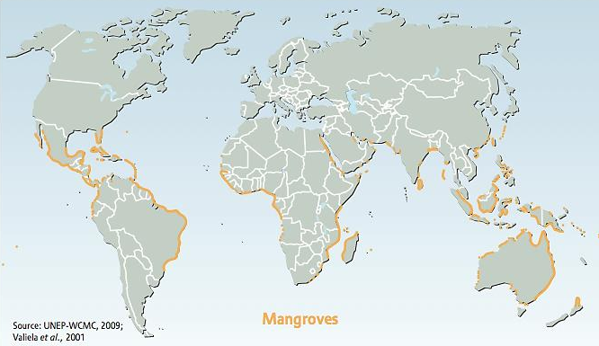
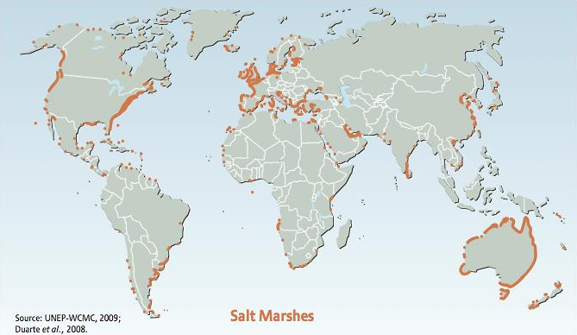
Atlantic-East Pacific Indo-West Pacific
Notes:
Mangroves span the tropics and poke into the subtropics, as far ~30°N and even further South to 37°S.
Herbaceous species occur throughout the tropics and temperate areas, but they dominate in pure stands in the temperate zones that lack mangroves.

Slide 5
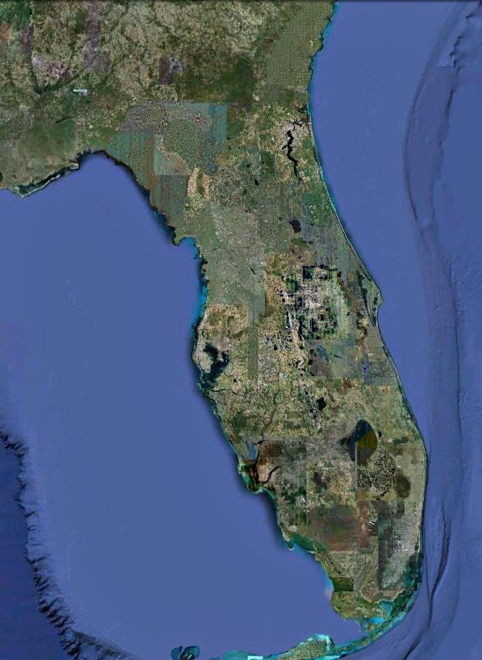
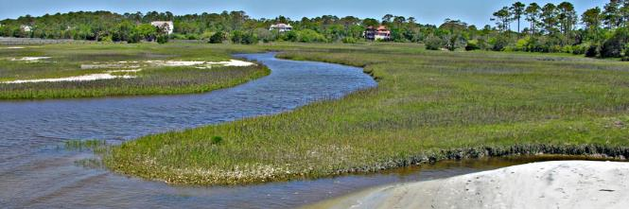
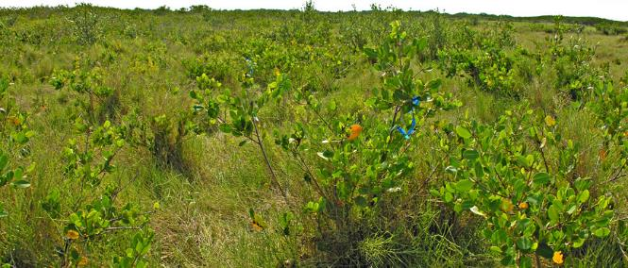
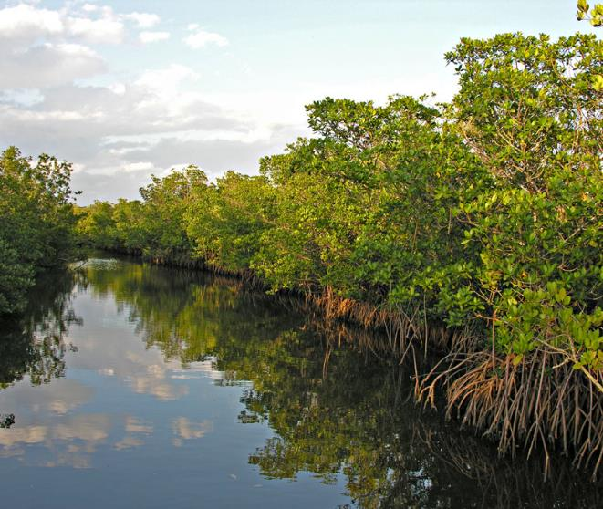
Pure Saltmarsh
Mangrove-Saltmarsh Ecotone
Pure Mangrove
Notes:
Throughout this global range there are ‘mixing’ or transition zones that contain both mangroves and salt marsh species. These ecotones are dynamic in space and time, and are the center of all the action!
For example, I am showing here our focal ecotone on the Eastern coast of Florida, a linear zone of about 3 degrees of latitude and perhaps 300 kilometers that contains – betwixt and between the condos and retirement communities – replicated habitats with varying levels of mangrove establishment. North of St Augustine up through Jacksonville it is pure salt marsh all the way up to Newfoundland on soft-bottomed substrates.

Slide 6
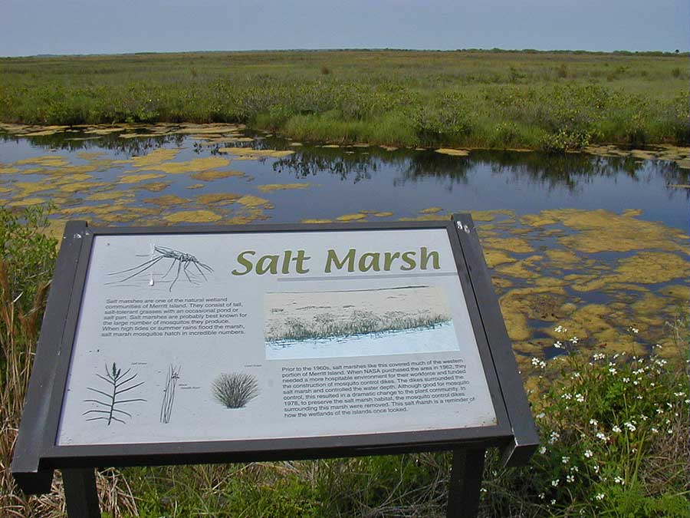
…28°40′ N, Merritt Island National Wildlife Refuge
Notes:
People such as Candy Feller who have worked long-term in these systems have noticed pronounced change over the past 10-20 years, not just in Florida but in marsh-mangrove ecotones worldwide.
For instance, here is an educational display in the Merritt Island National Wildlife Refuge, right in the center of the current mangrove/salt marsh ecotone. The sign describes this area as a salt marsh and says that the plant species that occur here are salt tolerant grasses.

Slide 7
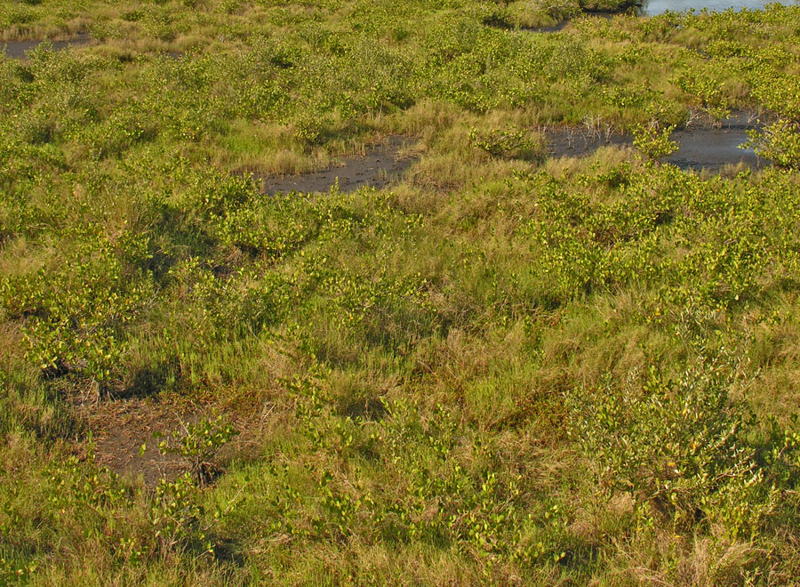
…28°40′ N, Merritt Island National Wildlife Refuge
Notes:
This system on Merritt Island is still a coastal wetland, but it has changed since the sign was put out.
A close look shows that mangroves have invaded since the sign was set up… here mainly Avicennia has become established in this wetland. There is now as much mangrove as there is salt marsh.
Globally, there are increasing reports of Poleward expansion of mangroves but also mangroves moving inland and upland as sea levels rise and salt waters penetrate further inland. We heard this on NPR the past view days as Barack Obama visited the Everglades.

Slide 8
What are the Drivers?
What are the Consequences?
Drivers
Abiotic: changes in temp, precipitation, CO₂, sea-level rise, frequency & intensity of disturbances
Biotic: competition, herbivory, pollination
Consequences
Changes in biomass, carbon storage, diversity, shoreline stability, nutrient cycling, community structure
Notes:
Overall, our team effort has sought to document the pattern of mangrove expansion and critically test a number of hypotheses for abiotic and biotic drivers, which should operate at multiple spatial and temporal scales. We are working in all of these areas.
For today, I will focus the majority of our time on hypotheses for abiotic drivers, primarily climate and temperature.
Briefly I will touch upon one biotic driver: herbivory, which could play a role in ‘enemy release’ at the edge of mangroves’ geographic range
Then I will discuss some consequences, primarily in terms of changes in community structure and diversity.

Slide 9
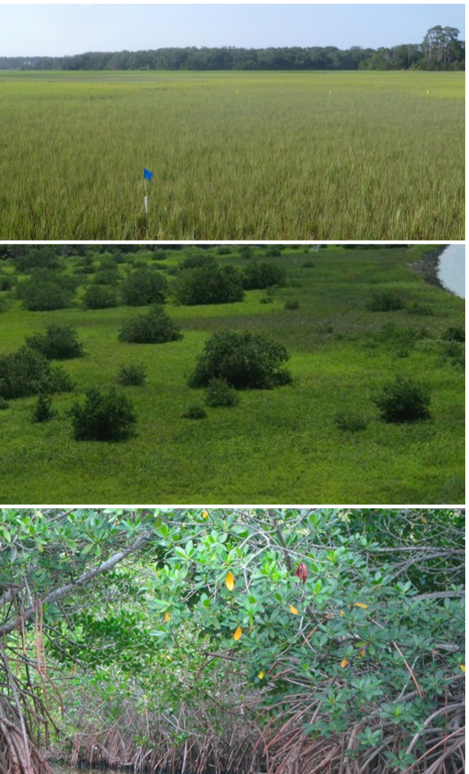
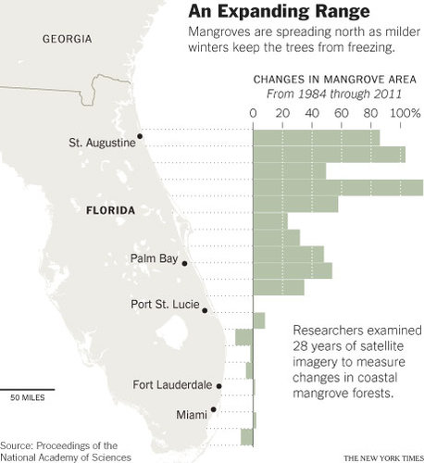
Mangrove area expanded within the ecotone, 1984-2011
Cavanaugh et al. 2014 PNAS
Notes:
First we sought to document the pattern to convince ourselves with data that it is happening.
Kyle Cavanaugh used 4 “Scenes” from Landsat Thematic Mapper from 1984 to 2011, selecting one cloud free image of each for every year between April and July.
You can see here in the coverage from the New York Times, the over those 28 years mangrove cover increased at all points North of about 27 degrees latitude, in some cases more than doubling in cover.
These changes were not correlated with land cover, sea level changes, precipitation, or any other variables describing changes in the annual means of climate variables over time.
However, the change in mangrove areal cover WAS related to a decreasing severity of winter cold events, with the critical break occurring between -3 and -4 C (or colder) on one or multiple winter days.

Slide 10
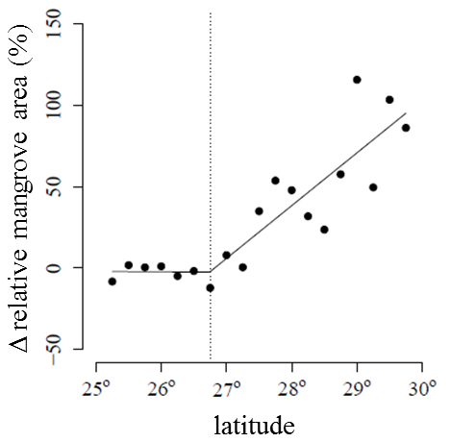
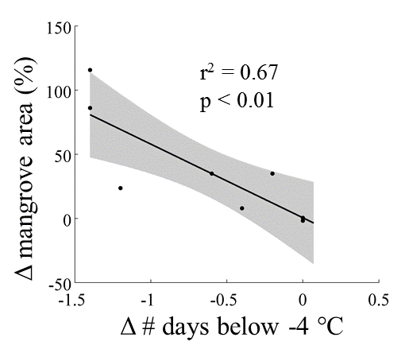
Mangrove area expanded within the ecotone, 1984-2011
Cavanaugh et al. 2014 PNAS
Notes:
At the top, you can see this clear breakpoint at just under 27 degrees latitude where cover goes from constant over time to a steep increase in areal coverage, peaking at 100% increase or a doubling in area towards 30 degrees latitude.
These changes were not correlated with land cover, sea level changes, precipitation, or any other variables describing changes in the annual means of climate variables over time.
However, the change in mangrove areal cover WAS related to a decreasing severity of winter cold events, with the critical break occurring between -3 and -4 C (or colder) on one or multiple winter days.
(((I should note that we also examined changes in precipitation and land use across our study area, but these variables did not explain changes in mangrove area. In terms of land use, we specifically looked into changes in urban and agricultural land cover in coastal watershed. One hypothesis is that eutrophication from urban and agricultural land can enhance mangrove growth from nutrient enrichment. But land cover changes did not match these patterns of mangrove expansion. )))

Slide 11
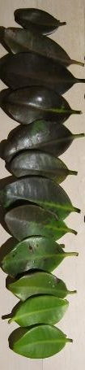
Lab experiments: mangroves have species-specific threshold responses to freezing temperatures
Photoinactivation: change in chlorophyll fluorescence yield (Y) after freeze event
Black mangroves (A. germinans)
29.92° N, 81.31° W
Red mangroves (R. mangle)
29.73° N, 81.24° W
White mangroves (L. racemosa)
29.66° N, 81.22° W
A. germinans
R. mangle
L. racemosa
Cavanaugh et al. (2015) Global Change Biology
Notes:
To assess susceptibility to cold, in the lab John Parker, Susan Cook-Patton, Kyle Cavanaugh and others measured photoinactivation, or the change in chlorophyll fluorescence yield (Y) after a freeze event.
They placed a very large number of living branches of the three species into the freezer at temperatures ranging from zero to -11 C.
We measured yield before and after the freeze treatment with a mini-PAM (Photosynthetic Yield Analyzer) and quantified photoinactivation as 1 – Y_{post}/Y_{max}
Photoinactivation thus ranged from zero (no loss of photosynthetic function) to one (complete loss of photosynthetic function).
Results: The black mangroves were the most tolerant, then reds, then whites.
These correspond to the order of their latitudinal range limits in Florida:
The northernmost stand of black mangroves was located at 29.92° N, 81.31° W,
the northernmost stand of red mangroves was located about 23 km further south at 29.73° N, 81.24° W,
and the northernmost stand of white mangroves was located about 7 km south of the red mangroves at 29.66° N, 81.22° W

Slide 12
Lab experiments: mangroves have species-specific threshold responses to freezing temperatures
FDD = max([0 T_{base} - T_{min}])
A. germinans
AIC model selection showed FDD as the best climatic predictor of Δ mangrove area
R. mangle
L. racemosa
10% photoinactivation
(black mangroves: -3.2°C)
Cavanaugh et al. (2015) Global Change Biology
Notes:
And finally I want to point your eyes to this 10% level of photoinactivation. This was used as a baseline for deriving a new climate metric for these mangroves, freezing degree days (FDD), based off of these experimental results
Supp Methods: In June 2013 we collected branches from black, red, and white mangroves in Avalon State Park at the Southern end of the ecotone (27.55° N, 80.33° W). To maintain the physiological integrity of the branches, we removed a long branch from each tree, cut off the top ~ 15 cm of the branch under water, and placed this tip directly into floral water tubes. We then placed branches in a freezer for 4.5 hour trials, using a thermoregulator (Aqua Logic EC115R) to maintain a steady temperature. We conducted a total of 21 different trials, with average minimum temperatures in each trial ranging from -0.2°C to -11.0°C (recorded with HOBO data loggers). We included branches from 20 individuals per species in almost all trials (N = 420 blacks, 418 reds, and 360 whites), except for the -5.3°C trial, which had 18 red mangrove individuals and zero white mangroves, and the -4.2°C and one of the -6.7°C trials, which also had zero white mangroves.

Slide 13
We developed a new climate metric, freezing degree days (FDD), based off of our experimental results
FDD = max([0 T_{base} - T_{min}])
T_{base}= -3.2°C (10% photoinactivation for black mangroves)
FDD captures both the intensity and frequency of freeze events each year
FDD is a better predictor of mangrove distribution than other temperature based metrics (e.g. mean annual temperature, mean winter temperature, annual minimum temperature)
Climate metric for single variable distribution model | AIC
Mean annual temperature | 3525
Mean winter temperature | 3356
Annual min temperature | 3296
# days < -3.2°C | 2759
Freeze degree days (using -3.2°C as T_{base}) | 2728
Cavanaugh et al. (2015) Global Change Biology
Notes:
We used this FDD winter severity index to predict changes in mangrove cover over the 1984-2011 time series.
We used a 10% photoinactivation from the prior graphical model as the “base temperature” because it would be more likely to capture the impacts of minor freezes than a threshold based on the inflection point of the sigmoid curve (i.e. the temperature corresponding to 50% photoinactivation).
We used the threshold temperature of the most tolerant species, Avicennia germanins, which resulted in a threshold of -3.2° C.
This is like counting Degrees Days for monitoring predicting phenology, however in this case the goal is to identify the temperature below which plant growth and development ceases.
We created a series of logistic regression models to relate mangrove presence/absence (from prior Landsat database) to modern climate. Model selection via AIC chose FDD as a better predictor than any other climatic variables, even better than the #of hard freezes reported in the prior paper.
More methods: We characterized modern climate using gridded daily minimum temperature (T_{min}) data for 1981–2010 from Maurer et al. (2002). The original resolution of the data was 1/8°, which we statistically downscaled to 30 arc-second (~800 m) geographic resolution. We then developed a mangrove presence/absence dataset with the same spatial resolution as our climate data (800 m). Our analysis was restricted to cells that contained estuarine and marine wetlands according to the US Fish and Wildlife Service National Wetlands Inventory. Mangrove presence/absence in each cell was determined using data from two mangrove distribution datasets (Spalding et al. 2010; Giri et al. 2011b). A composite of the two datasets was used in order to minimize errors of omission. The available mangrove presence/absence datasets did not differentiate among species, and so all three species of mangroves were grouped together for this analysis.
We developed single predictor logistic regression models to predict mangrove presence/absence and used Akaike’s Information Criterion (AIC) to measure the relative quality of each model.

Slide 14
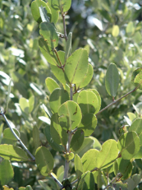
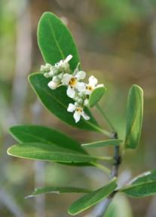
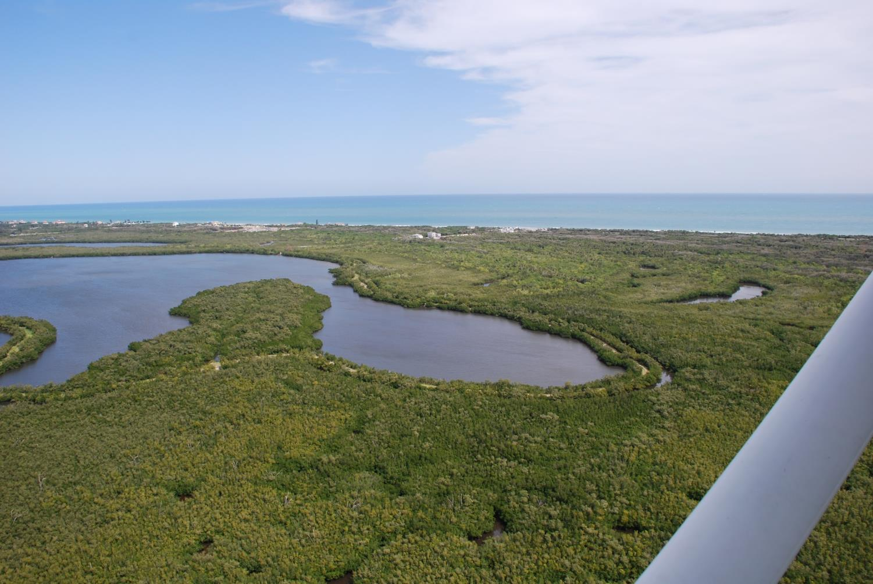
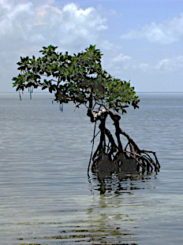
Red mangrove
Rhizophora mangle
White mangrove
Laguncularia racemosa
Black mangrove
Avicennia germinans
Notes:
However, the results from Landsat I’ve shown you thus far could not distinguish the three species of mangroves in areal cover – the Landsat imagery was too coarse grained to pick up individual species. So, we located several areas where it was possible to find extensive stands far larger than a pixel from Landsat. These were groundtruthed and matched up to the imagery so that we could see if this FDD predicts the effects of hard freezes on the three species.

Slide 15
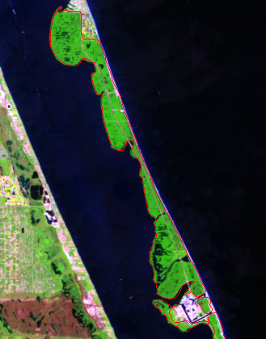
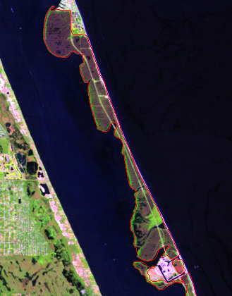
Net mangrove areal losses observed only in years where FDD was positive (minimum temperatures fell below -3.2°C)
1988
1991
mangrove
Notes:
In order to further test FDD as a predictor of the northern range limit for mangroves, we compared changes in mangrove area between summers to the cumulative FDD during the intervening winter.
We used time series of mangrove area from 1984 to 2011 derived from Landsat 5 Thematic Mapper (TM) imagery collected each summer, and checked it against the changes in area for our three species. We just used the conservative FDD of -3.2 for all three species.
No significant loss was observed in years that experienced mild freezes
The FDD for reds and whites would be a lower freeze threshold, but this analysis could not distinguish between the three species in the Landsat imagery of mangrove cover. This FDD for black mangroves is the most conservative.
ADDITIONAL METHODS: Using a handheld GPS, we identified areas in Avalon State Park (where branches were collected for laboratory analysis, 27.55° N, 80.33° W) and Sebastian Inlet State Park (27.85° N, 80.45° W) that contained large (> 30 m x 30 m), monospecific stands of red, black, and white mangroves in close proximity to each other. We then identified the Landsat pixels that were within each outlined stand such that the Landsat pixels represented pure species-specific stands of mangrove trees. We calculated each year’s cumulative FDD values. For each of three stands in two sites, we compared the annual change in mangrove area between successive summers to FDD of intervening winter for each year that experienced a freeze

Slide 16

FDD-based mangrove distribution models project continuing poleward expansion of mangroves over next 50 years
Projected mangrove distributions for 2060
Species-specific migration modeled based on 21 general circulation projections (CMIP5) of changes in freezing degree days along east coast of FL
Projected poleward migration rates: 2.2 km/yr (R. mangle & L. racemosa) to 3.2 km/yr (A. germinans)
Notes:
We used downscaled climate projections to forecast future range limits for each species. To characterize future climatic conditions we used daily T_{min} from 2030 to 2060 from an ensemble of 21 general circulation models (GCMs) as part of the 5th phase of the Coupled Model Intercomparison Project (CMIP5) .
So in yellow you see the projected ranges for the three species and green is the current range.
The current (1980-2010) FDD value at the location of the northernmost stands of black, red, and white mangroves was inferred to be the threshold for presence of each of the 3 mangrove species. We then identified cells that crossed this threshold in the 2030-2060 climate projections.

Slide 17
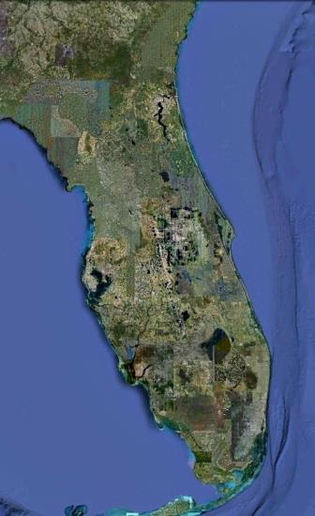
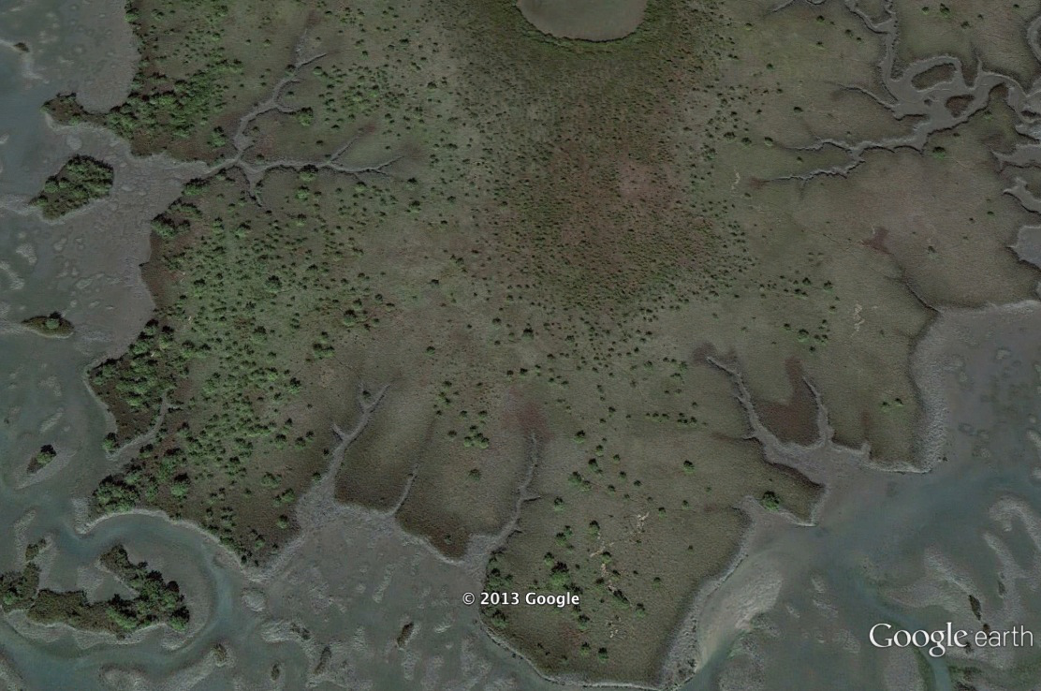
Sentinel sites: e.g., North Matanzas
Notes:
Landsat gives us a broad view in time and space, but a fairly coarse one.
At the same time, much of the Eastern coast of Florida is not exactly unmolested by the agency of mankind.
So we’ve also narrowed down on several focal sites that can give us more detailed, fine-grained information and which have been spared development over the past decades.
This is a view of our N. Matanzas site, about 160 km N of Cape Canaveral. You can see that in 2013 it is fairly peppered with Black mangrove trees within the saltmarsh ecosystem

Slide 18
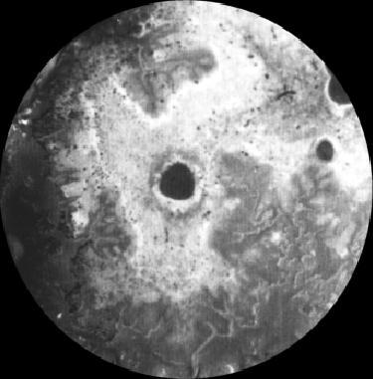
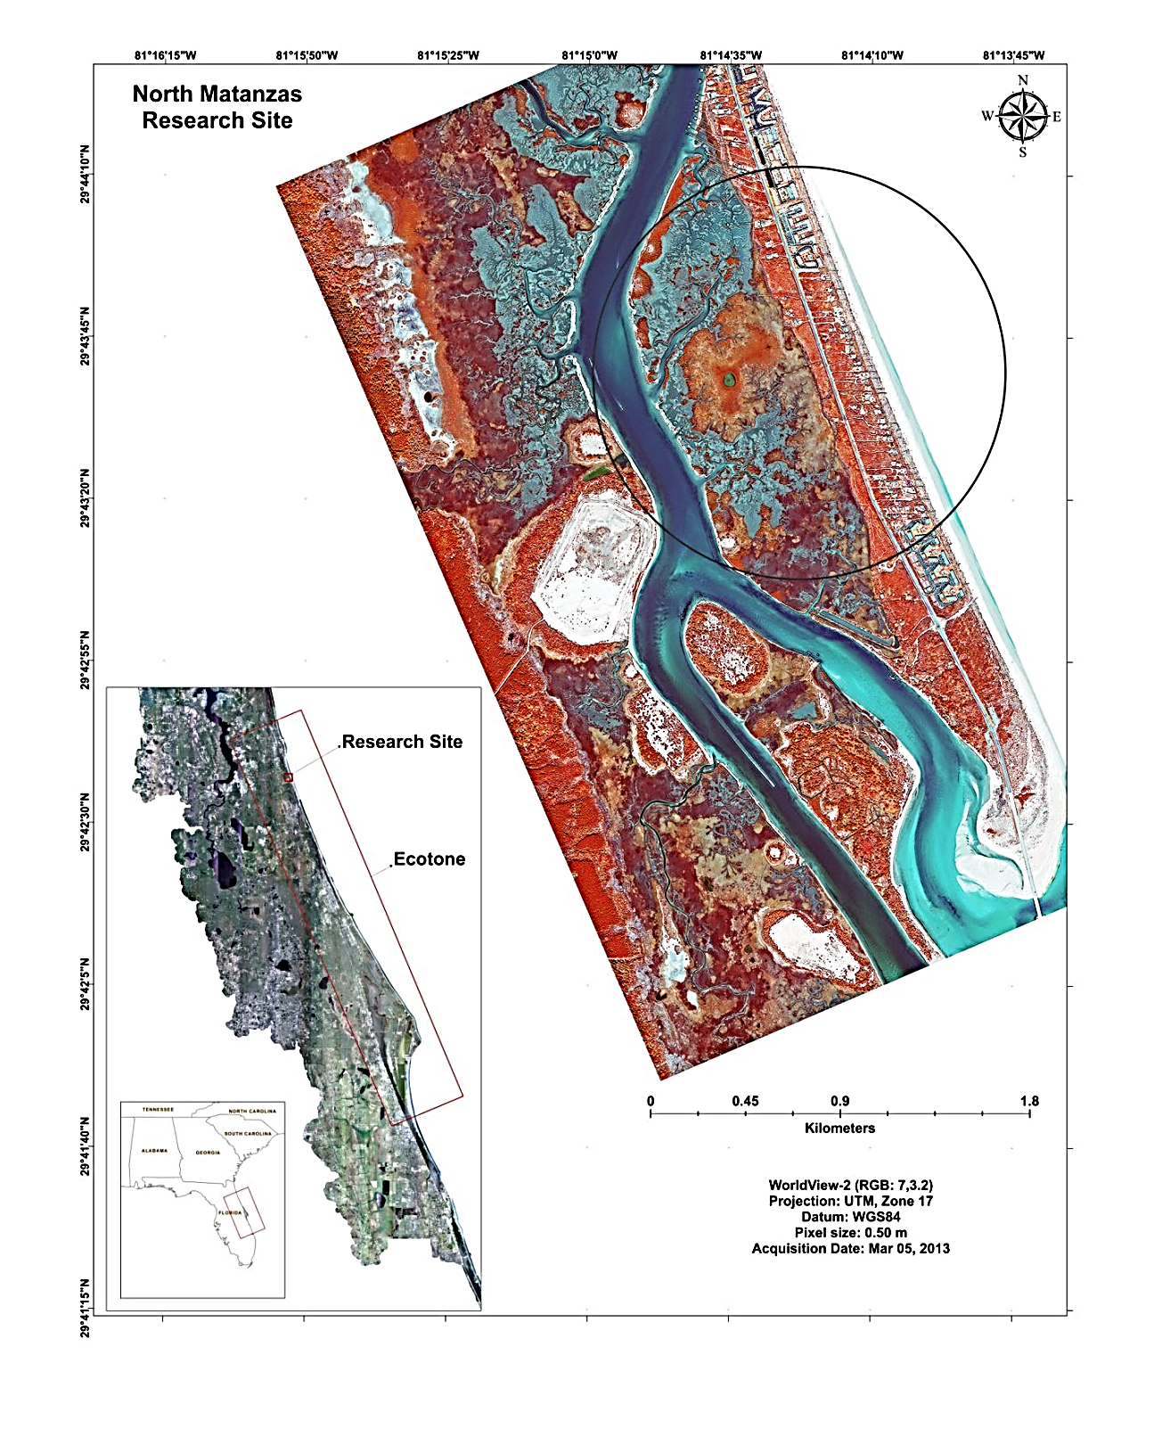
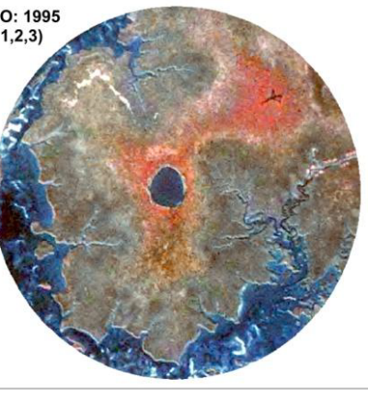
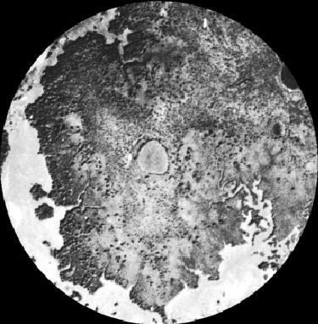
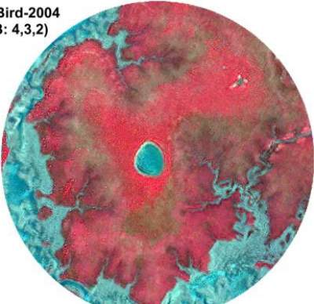
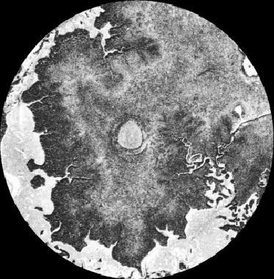
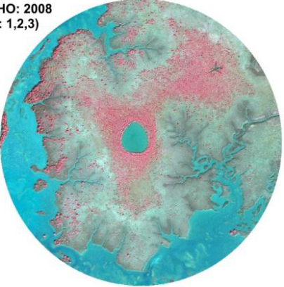
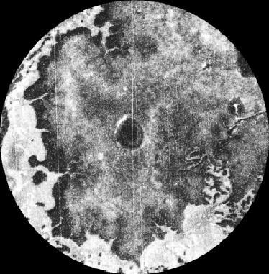
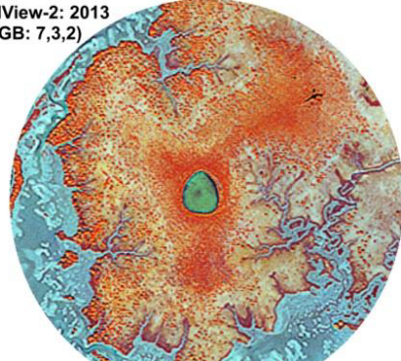
1942
1951
1971
1980
…1971 to 2013, ~0.24 ha per yr increase
Rodriguez et al. 2015
Notes:
From several sites like this, Wil Rodrguez was able to track down historical aerial photography that in some cases even pre-dates WWII, georeference it, and combine it with later multispectral high resolution satellite imagery from IKONOS, Quickbird, and Worldview2
Results of our habitat classification shows a positive and significant (R² = 0.8784; P = 0.0058) increase of mangrove vegetation from 1971 to 2013, a time period of 42 yrs. The slope of the non-linear regression line for this site showed a rate of change of approximately 0.24 ha in increased mangrove area per yr.

Slide 19
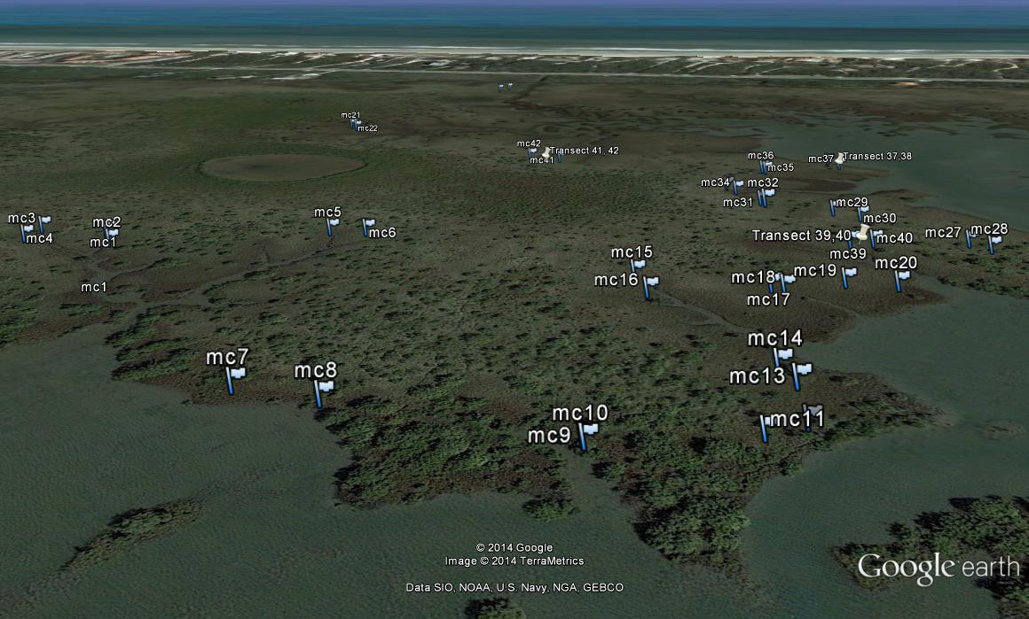
Notes:
Also at the Matanzas focal site, our team placed temperature data loggers out into the field to track temperatures in and around mangroves and out in the open saltmarsh over the course of cold winters.
We expected it to be colder and more variable in temperature on the open marsh relative to loggers placed under mangrove cover.

Slide 20
Range: -2.4°C to 30.0°C
Range: -3.7°C to 38.9°C
In
Out
Min: -2.4°C
Min: -3.7°C
Notes:
Snapshot from one recent cold event:
Temperatures from noon on 6Jan2014 to noon 8Jan2014, logged every 30 minute. Data from INSIDE a mangrove tree in black, OUTSIDE in blue. Gray is less than zero, and dashed line equals -4C.
Over the larger time period from mid-December 2013 to mid-January 2014, the mean difference in minimum temperature was – 1.4 C (colder in the open)
This demonstrates the potential for a positive feedback mechanism, whereby there are fewer hard freeze events than before, but those freeze events are LESS COLD locally around the nucleus of a growing mangrove stand than they would be in the open marsh!

Slide 21
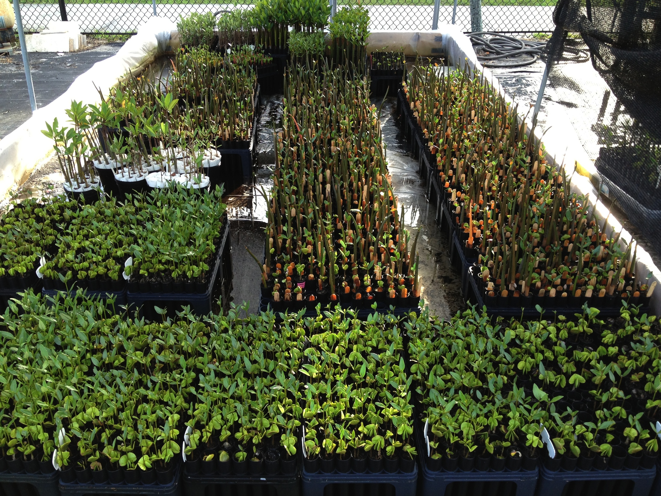
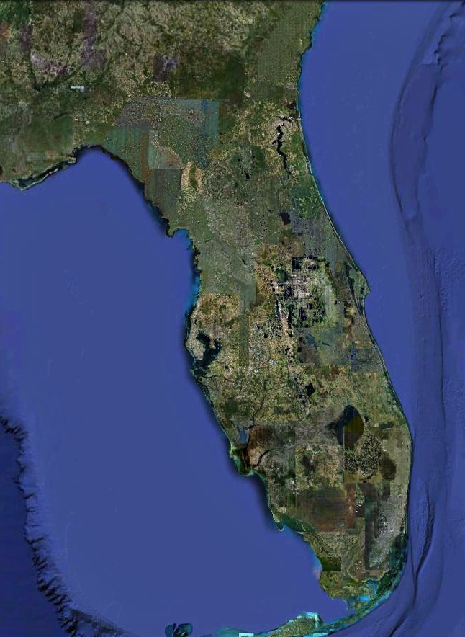
Relative to Southern propagules, Northern propagules:
are more freeze resistant
grow taller and faster
have smaller leaves and lower SLA
reproduce earlier and at smaller size
Current evidence is more consistent with acclimation/plastic responses, rather than heritable adaptive differences among populations
Cook-Patton et al 2015 Functional Ecology, Dangremond unpubl.
Notes:
Using plants grown in a massive common garden at SMS at Ft Pierce, where we grew tens of thousands of propagules collected from all along the East Coast of Florida, we’ve established that:
Relative to Southern plants, Northern plants:
are more freeze resistant
they elongate and grow taller, more quickly, with smaller leaves and lower SLA
and they reproduce much earlier and at much smaller size.
As far as we can determine, these results are more consistent with an acclimation or plastic response than with a heritable or adaptive difference in populations.

Slide 22
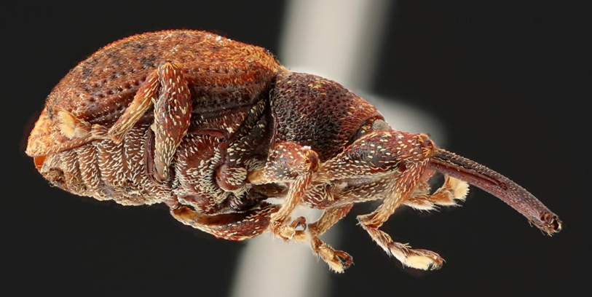
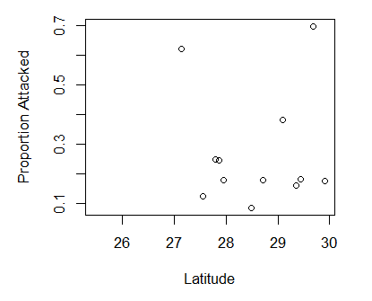
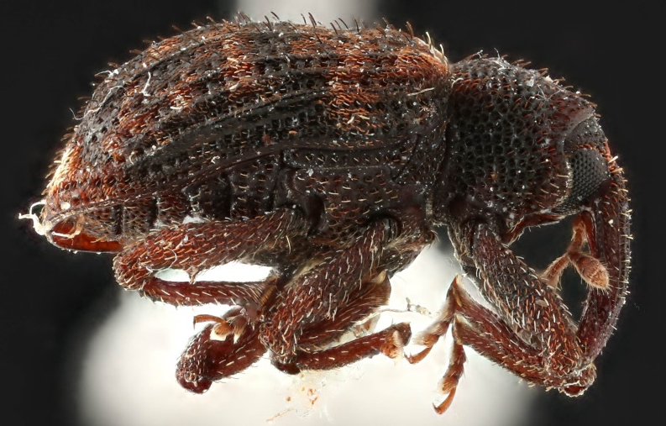
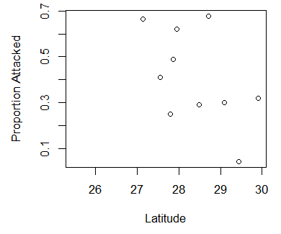
Mangroves have not escaped consumers at range edges:
No trends in propagule predation with latitude
Avicennia, pre-dispersal
Avicennia, post-dispersal
Notes:
Regarding BIOTIC DRIVERS, one hypotheses we had was that perhaps mangroves are expanding in part because, outside their core range, they can escape damage from specialized seed predators and herbivores? In other words, are they showing signs of “enemy release”?
We collected propagules still attached to trees of the three species, and later, propagules that had dropped and dispersed months later. We dissected all of these to look for seed predators.
In both pre- and post-dispersal datasets for the 3 species, we saw no strong evidence of a latitudinal pattern that would indicate more release at higher latitudes.

Slide 23
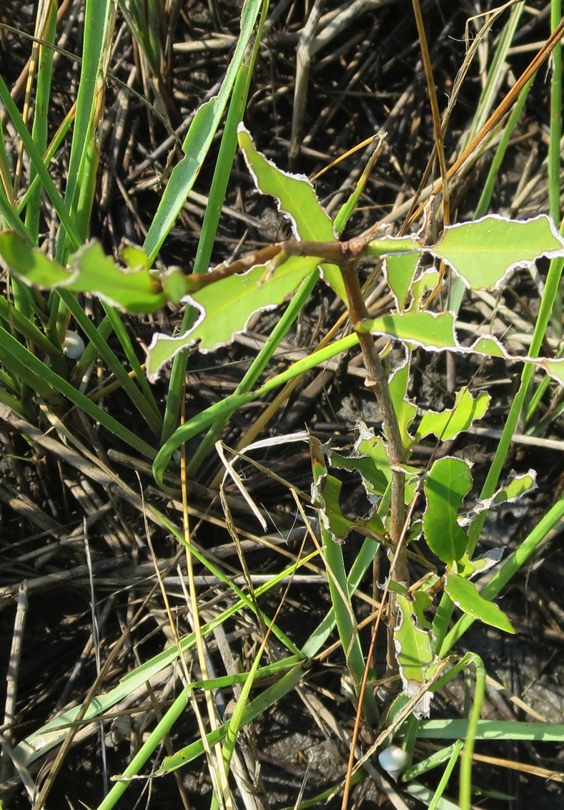
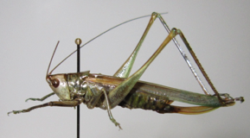
Marsh-associated generalist herbivores heavily damaged mangrove seedlings
Alex Forde unpubl data
Notes:
Moreover, in outplantings of mangrove seedlings into saltmarsh outside the current range of the ecotone to the North, mangroves get hammered, in particular by generalist grasshoppers and katydids that are associated with the marsh grasses.
The mangrove seedlings experienced higher herbivore pressure when planted in high density.
And there were more katydids evident in taller Spartina cord grass stands.

Slide 24
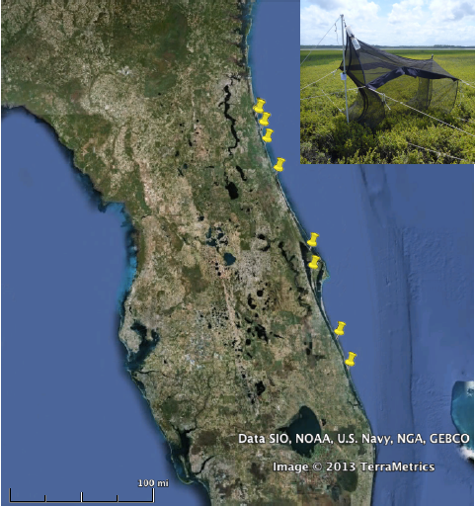
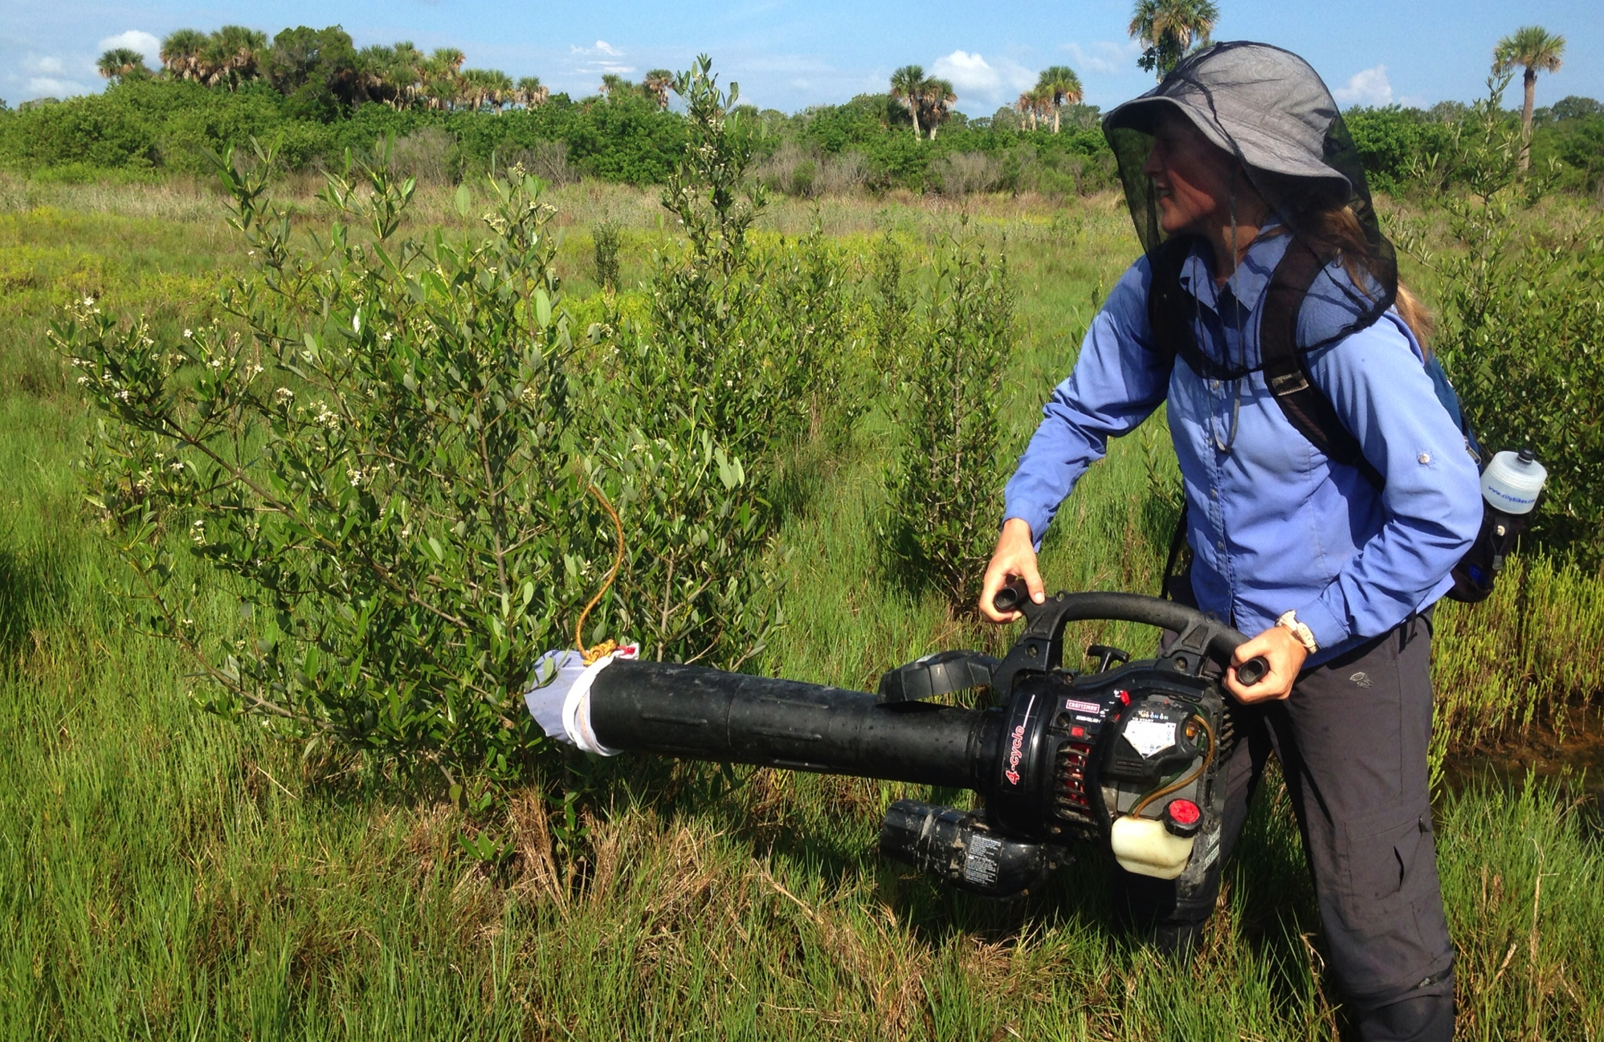
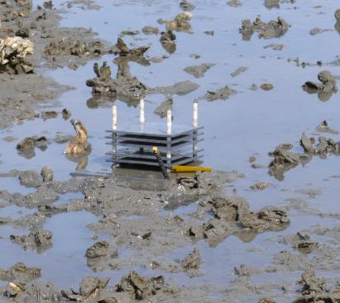
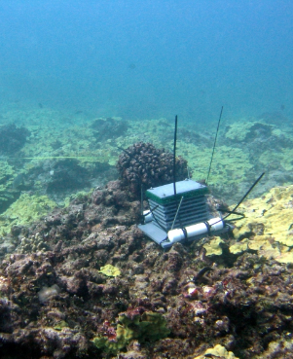
Consequences: how does the expansion of mangroves impact ecosystem processes and community structure?
Sampling of food web structure in terrestrial and marine communities
Field sampling of structural complexity
C & N flows from stable isotope analysis
Observations of decomposition rates
Nutrient sampling of soils, sediments, and seawater
Notes:
How does this transition changes community structure and ecosystem functions such as nutrient cycling, decomposition, C storage, etc. ? We are field sampling and running experiments addressing all of these areas.
But I will focus here just on the community sampling to ask how a changing landscape will affect terrestrial and marine arthropods – insects & spiders on land, and crabs below the tide line.

Slide 25
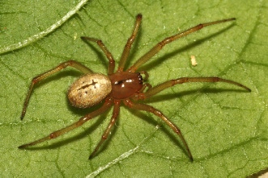
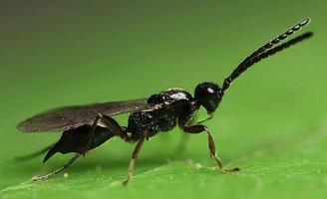




Arthropod communities on marsh & mangroves are distinct
Forde, Nathan et al. unpubl data
Notes:
Arthropod communities on marsh & mangroves are distinct – largely, it is easy to discern two large groups, distinguishing mangroves (black and green) from marshes (yellow and blue), with less evidence of structuring between those two inside versus outside of ecotone habitats.

Slide 26
Diversity on marsh plants, but not on mangroves, is higher within the ecotone
Forde, Nathan et al. unpubl data
Notes:
However, evidence shows that species richness of arthropods holds steady on mangroves inside and outside the ecotone, but it is clearly much greater for marsh species inside the ecotone compared to samples from “pure” habitats outside.

Slide 27


Planktonic larval crab supply shows little geographic community structure
Relative abundance
Analysis: manyGLM(supply ~ environmental factors)
Cora Johnston unpubl data
Notes:
Now peeking below the tide line and indeed outside the protected lagoons, graduate student Cora Johnston has been collecting zooplankton from the inlets across the latitudinal gradient, and she sees very little evidence of structural changes from place to place.
In the plankton, the larval crabs are mostly churned and mixed up.

Slide 28

Settling crab community assembles by vegetation type
Relative abundance
manyGLM(settlement ~ environmental factors); by vegetation type P=0.001
ANOSIM (Chord, standardized); R=0.1, P=0.0061
Cora Johnston unpubl data
Notes:
But once they settle, they show selectivity (confirmed in mesocosm trials) that shows differences among red and black mangroves and in salt marsh habitats.
Overall the results for diversity are similar to the terrestrial arthropods: mangroves in the ecotone seem to add to the existing pool of marsh species, elevating local richness.

Slide 29






122km
Bugguide.net
Riley et al 2014 SE Naturalist
Notes:
And finally, are these crabs shifting their ranges alongside the mangroves? The most interesting case comes from the mangrove tree crab, Aratus pisonii.
It was thought to be an intimate associate with mangroves – it climbs into the trees -- hence the name.
In 1918 it was found only in Southern Florida.
However, we began to notice it far to the North, and Megan Riley and Cora Johnston in formal surveys found the beast well into Southern Georgia – at least 122 km beyond the Northern range edge of the mangroves.
This species is rapidly outpacing the Poleward expansion of mangroves, using structures such as docks and pilings and even grass fronds to do the climbing it seems to prefer.

Slide 30

Thank you!
Lorae Simpson, Mike Lehmann, Lisa Duckett, Megan Riley, & many undergraduate scientists
NASA Biodiversity & Ecological Forecasting Team
Smithsonian Marine Station at Fort Pierce
Guana Tolomato Matanzas National Estuarine Research Reserve
Florida State Parks
Canaveral National Seashore & Biscayne Bay NP
Merritt Island, Pelican Island, & Hobe Sound NWR
Notes:
In conclusion, and with thanks to support from NASA over the past 3+ years, we have strong evidence that intolerance to hard freeze events sets the upper limit in latitude for Atlantic coast mangroves.
We see this in the long term record from aerial and satellite imagery, and also in evidence from physiology and ecology.
With climate changing and a reduction in hard freezes we can expect to see mangroves in Southern Georgia possibly within our lifetimes.
We see little evidence that herbivores and seed predators limit this range expansion, and it looks like mangroves will enhance local biological diversity as they carry their associates with them.

